Slide 1

Micro Credit Default
Archit Khanduja

Slide 2
Micro Financing
Microfinance is a banking service provided to low-income individuals or groups.
Microfinancing can have various models and is more flexible than mainstream loans.
Low-Income population with prepaid mobiles can be given loans in advance with a fixed repayment time along with the interest.

Slide 3
MFI-Telecom Collaboration
Client name- Aertel Telecommunications
Fixed wireless telecommunications network provider
Based on the budget operator model, offering better products at Lower Prices
Collaborating with an MFI to provide credit balance to customers; to be paid back in 5 days.

Slide 4
Problem at Hand
It’s hard to decide the eligibility for loans as credit scores don’t work with MFIs.
Defaulters can increase the cases of bad debts and company will incur losses.
Company wants us to predict the potential defaulters so that it can refrain from pitching them the loan.

Slide 5
Prediction of Defaulters
Company has provided us with the customer data of 209593 entries.
All these customers have taken a loan and have either returned the money or turned out to be defaulters.
The dataset has 37 columns out of which 1 is the label column which tells whether the person has defaulted or not.

Slide 6
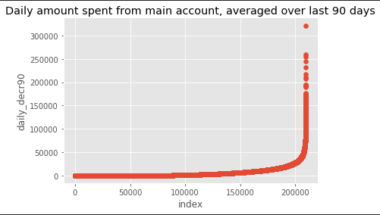
Insights from the Data
The above graph depicts ‘Daily amount spent from main account, averaged over last 90 days’. As we can see, there are a few values rising above 250000, which is quite unrealistic for a single person to spend in a day.

Slide 7
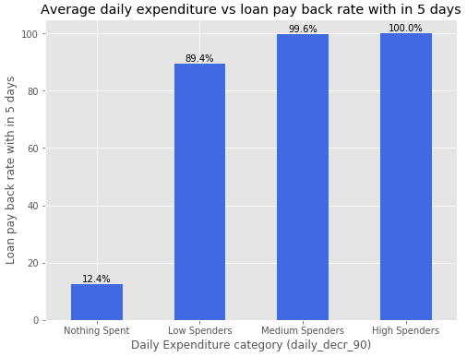
Insights from the Data
Those who spend more tend to pay back the loan and are less likely to be defaulters

Slide 8
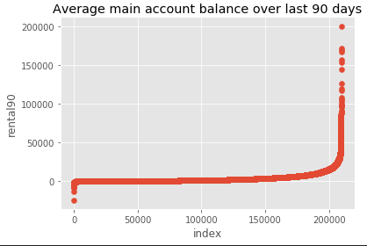
Insights from the Data
When we had a look at average main account balance over the last 90 days, it was found that a few values are going below 0 and some are going above 150000. The extremes are touching the unrealistic values.

Slide 9
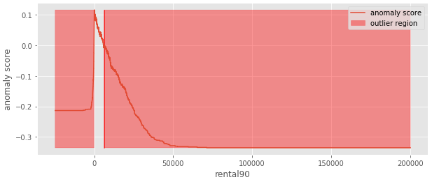
Insights from the Data
Since there were extreme values present in rental90, we were interested in knowing how much region is surrounded by the outliers. From the above plot, it is evident that majority of our data lies in a very small region and rest of it lies in the region of outliers. This can impact our model negatively and the model can gravitate towards outliers which will impact our accuracy score.

Slide 10
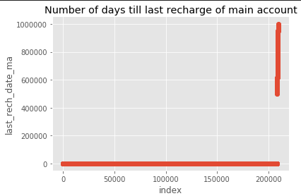
Insights from the Data
These are the number of days since last recharge. Some of the days are even more than 400000, which means more than 1000 years, when the mobile phones were not even invented.

Slide 11
Conclusions from Visualizations
The data is filled with outliers in almost all the attributes.
Some values are highly unrealistic. These unrealistic values are present in the outlier region and can be treated.
We cannot remove the entire rows in which the outliers are there as the data is costly.

Slide 12

Dropping the Features
Irrelevant features like unnamed, msisdin, pcircle and pdate were dropped.
After checking the correlation, it was observed that features with 30 and 90 days of similar attributes were highly correlated. All the features with 30 days were dropped as the data contained in them would be lesser than the data contained in 90 days.

Slide 13
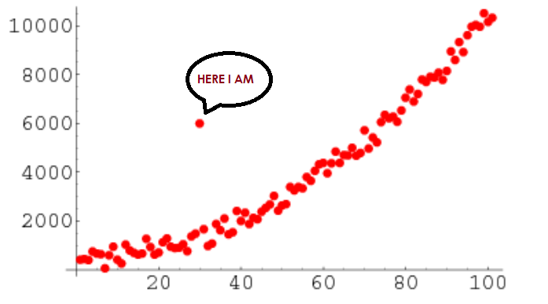
Treatment of Outliers
Cannot remove the entire rows having outliers because of the cost implications
Better to use median of the feature to impute outliers and then find the cube root of the values to normalize them

Slide 14
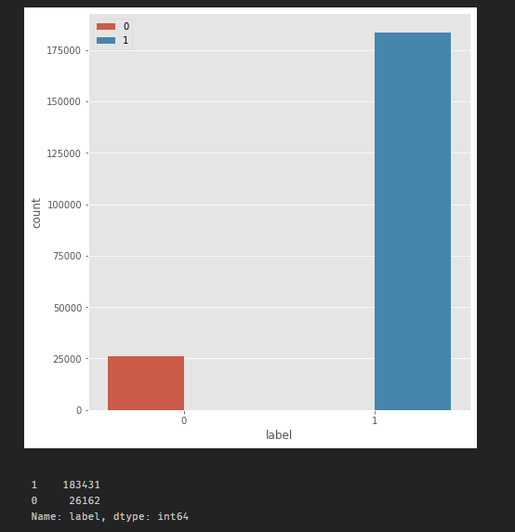
Imbalance in the Dataset
The label class, as shown in the adjacent figure is having a drastic difference between 1 and 0 values.
We have used SMOTETomek to treat the imbalance.

Slide 15
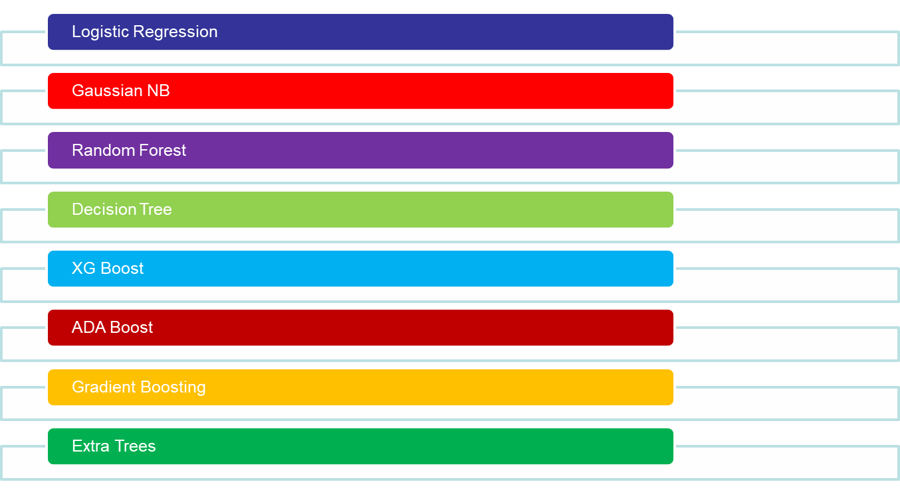
Model Building(Binary Classifiers)

Slide 16
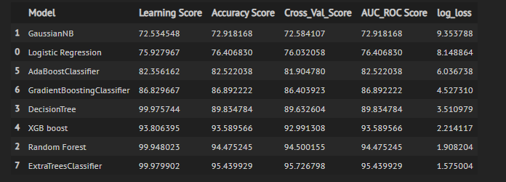
Results After Model Building
The best accuracy score was achieved with Extra trees and Random Forest.
Cross Val Score, AUC_ROC Score , Learning Score and Log Loss were used as key metrics.

Slide 17
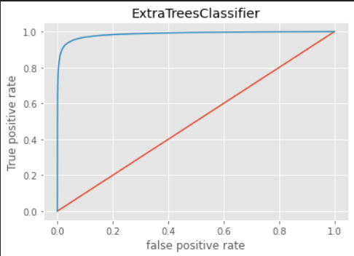
Final Touches to the Model
We have got 95 % accuracy with Extra trees. The score was slightly improved after tuning the Hyperparameters.
Predictions were made with probabilities and the results were saved in a csv file
AUC ROC Curve with 98% AUC

Slide 18
Results and Conclusions
We have successfully created a model which will predict a potential defaulter with 95% accuracy.
Tree based algorithms heavily outperformed the Euclidian distance based algorithms and linear algorithms in this case as expected.
daily_decr90, cnt_ma_rech90 and sumamnt_ma_rech90 are the most important features in the dataset and the company should focus their marketing strategies around these features.

Slide 19
Thank You

